Slide 1
Upflow correction method
EWEA Power Curve Working Group
London, 2015 December

Slide 2
Index
Introduction
Upflow angle definition
Upflow angle properties
Site calibration
Power curve measurement
Example (power curve measurement)
Site resources assessment
Conclusions
Presentation Gamesa 2014

Slide 3
Upflow correction method
Introduction
Flat terrains do not create a great variation of upflow angles, but it is very common in complex terrains to work under very different upflow angles depending on current wind direction
The upflow correction method tries to compensate the disorientation caused by a tilted rotor in a wind stream that is not perfectly horizontal
This correction tries to unify the wind speed input conditions to the rotor the same way the density correction method does
This method can be applied to the power curve verification at each 10min data record or to a reference power curve for resource assessment
The method is based on geometry and vector projections instead of energy assumption methods
Presentation Gamesa 2014

Slide 4
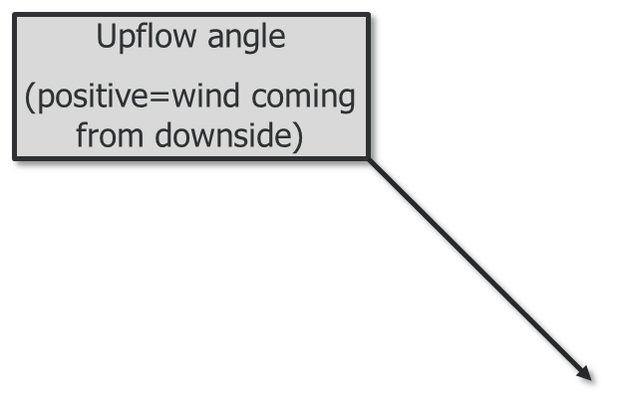
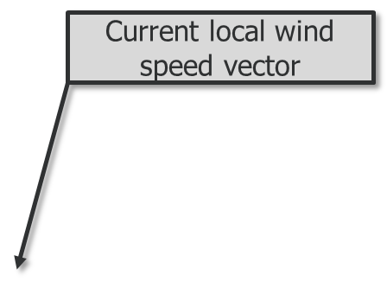
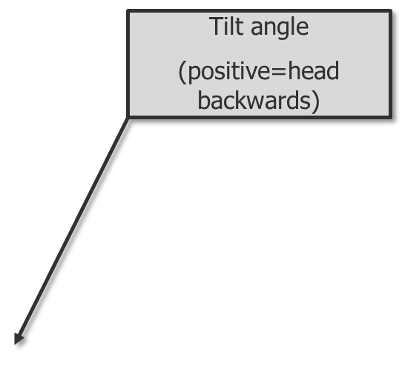
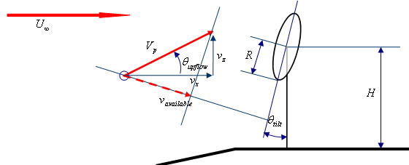
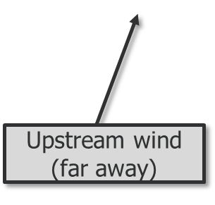
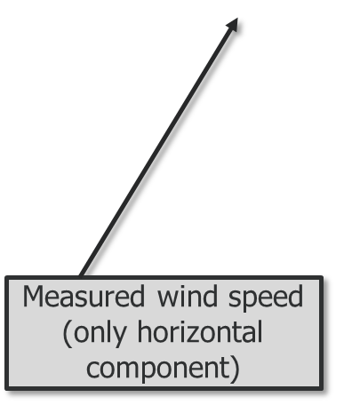
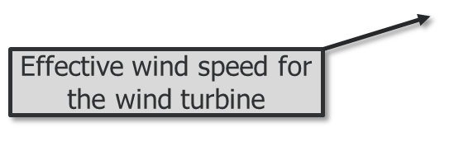
Upflow correction method
Upflow angle definition
Presentation Gamesa 2014

Slide 5
Upflow correction method
Upflow angle properties
Upflow angle is closely related to
Surrounding terrain slopes
Atmospheric stability
In a given site, the previous factors can be modeled roughly after
Wind direction Surrounding terrain slopes
Wind speed Atmospheric stability
Presentation Gamesa 2014

Slide 6
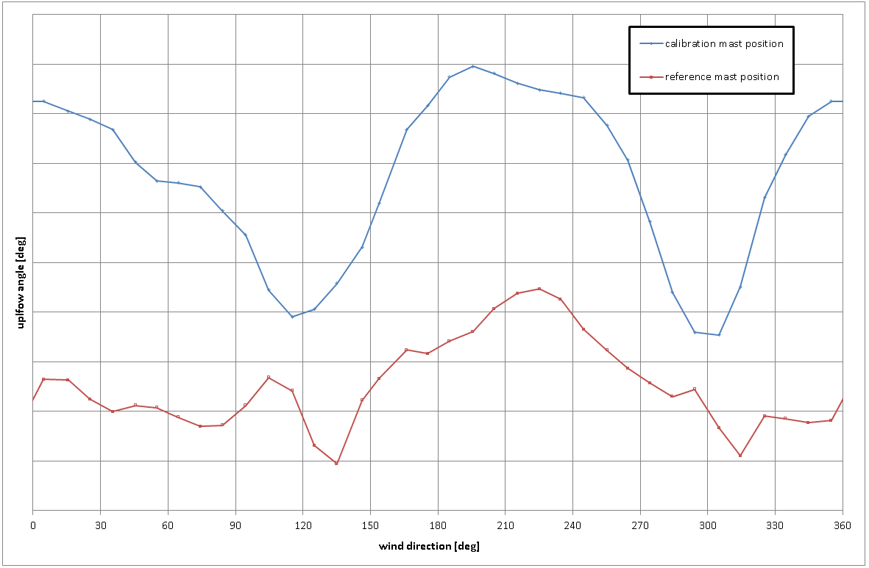
Upflow correction method
Upflow angle properties
Result seems to be very dependent of wind direction and location
Upflow angle at the reference met mast and the turbine location met mast, binned by wind direction
Presentation Gamesa 2014

Slide 7
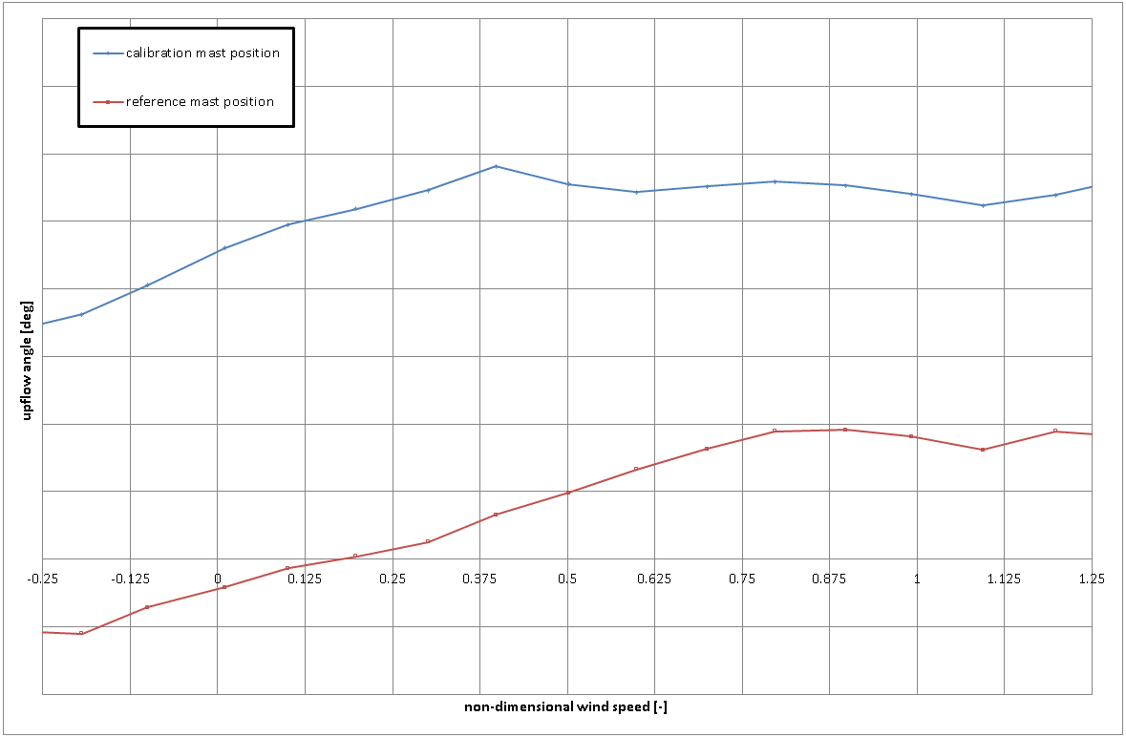
Upflow correction method
Upflow angle properties
Result seems to be somehow dependent of wind speed, but this may be a proxy of atmospheric stability and difficulty to establish the angle at low in speeds (worse angle precision)
Upflow angle at the reference met mast and the turbine location met mast, binned by wind speed
Presentation Gamesa 2014

Slide 8
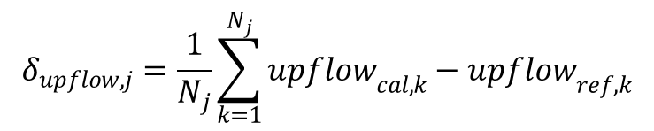
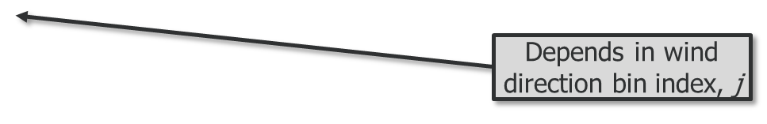

Upflow correction method
Site calibration
During site calibration, upflow angle must be calibrated also (as wind speed) from the reference mast to the turbine position mast.
The proposed calibration method is an offset application to the measured upflow at the reference mast position
This offset can be calculated binning the difference between upflow measured at the calibration position minus upflow measured at the reference mast position at each wind direction bin
To estimate upflow angle at the turbine position during power curve measurement, the previous correction is applied for each 10min data to the upflow recorded at the reference position (depending on wind direction bin)
Presentation Gamesa 2014

Slide 9
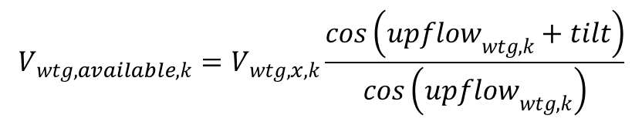
Upflow correction method
Power curve measurement
The perpendicular to the rotor wind speed can be calculated from the horizontal wind speed with a factor:
This correction can be applied:
After upflow at turbine position has been estimated
Before or after the density normalization
Before or after the site calibration
With or without REWS calculation
Presentation Gamesa 2014

Slide 10
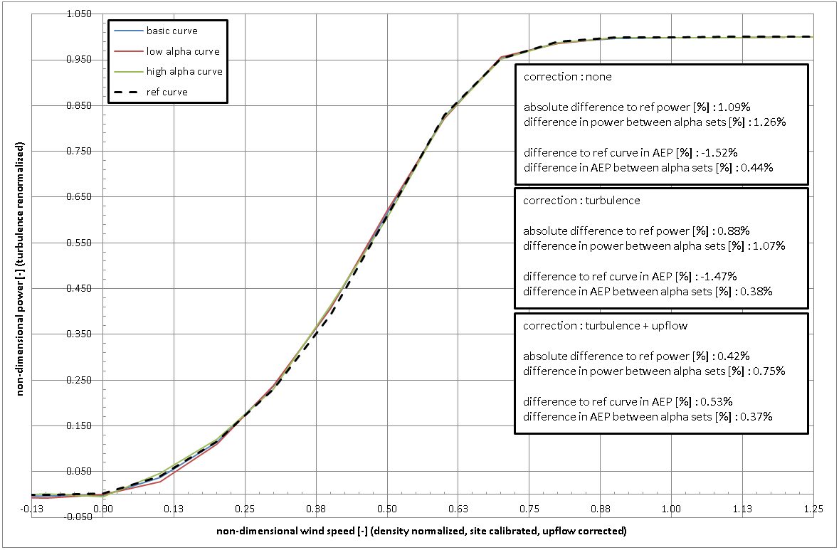
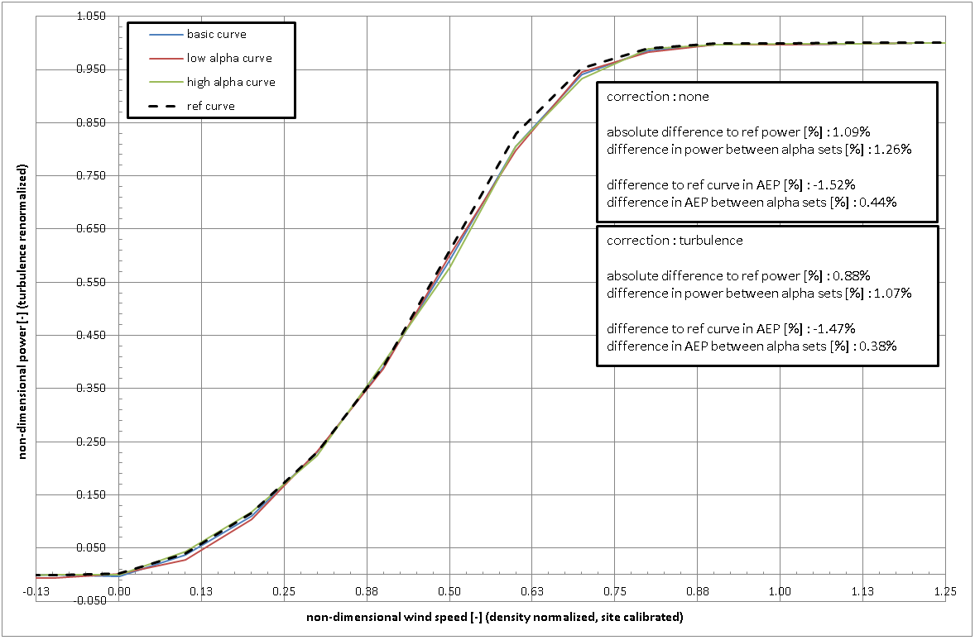
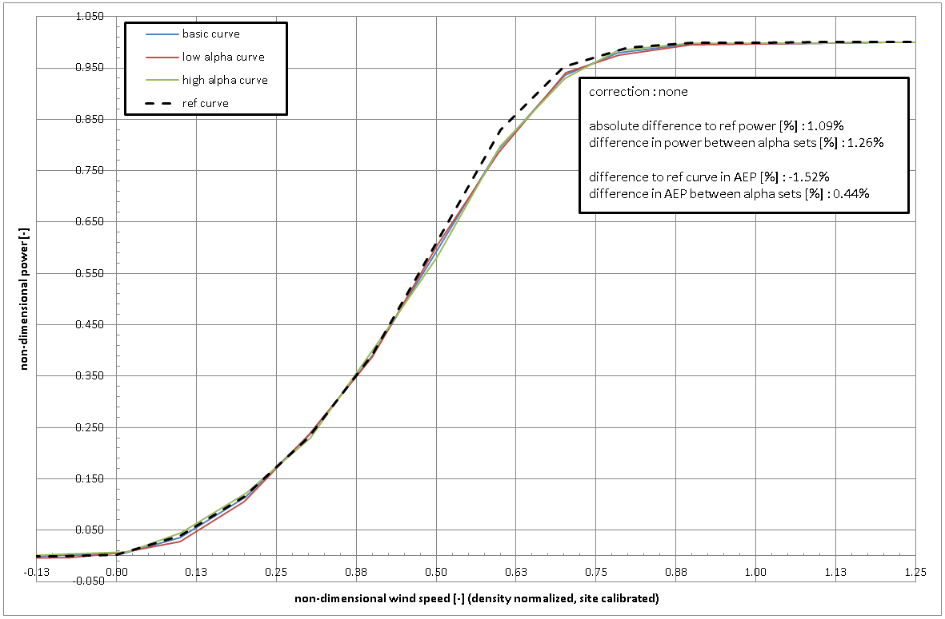
Upflow correction method
Example (power curve measurement)
Turbulence renormalization applied
Upflow correction applied
Each alpha set is supposed to have equal density, turbulence and upflow inputs
No corrections applied
Two sets with different alpha limits
Each alpha set has its own calibration
Turbulence renormalization applied
Each alpha set is supposed to have equal density and turbulence inputs
Presentation Gamesa 2014

Slide 11
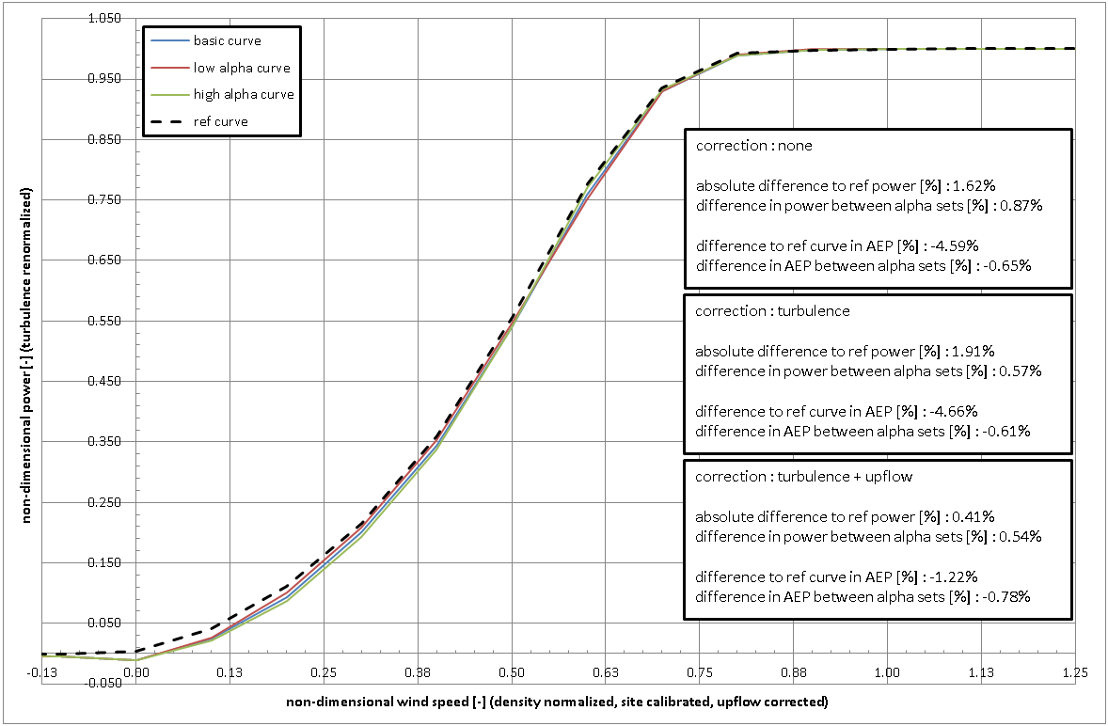
Upflow correction method
Example (power curve measurement)
Another example from a different site with the same post-processes
This terrain is more complex than the previous one
Presentation Gamesa 2014

Slide 12
Upflow correction method
Site resources assessment
In order to use this correction to establish a modified power curve corrected by upflow angle:
A reference power curve with no tilt and no upflow included (a reference power curve for perpendicular to the rotor wind speed reference is needed)
Upflow measurements or estimations (through CFD)
The corrected power curve can be created interpolating in the reference power curve with the perpendicular wind speed and referring the result to the wind speed bin center
Spline interpolation is preferred
  Cons: little overshoot at startup and nominal wind speed
  Pros: better correlation in all the wind speeds in between
Presentation Gamesa 2014

Slide 13
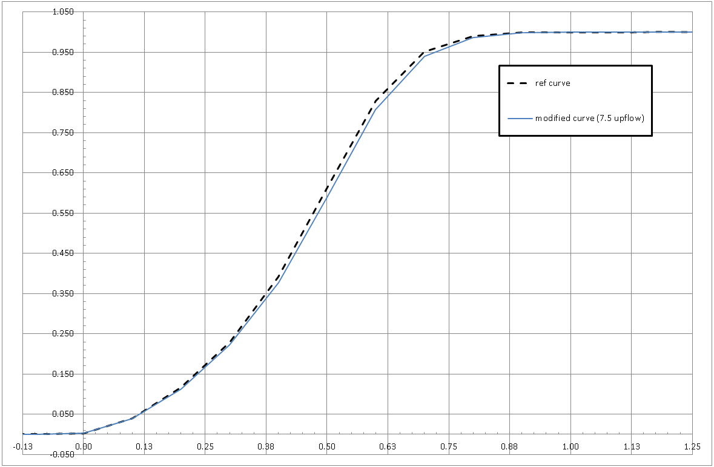
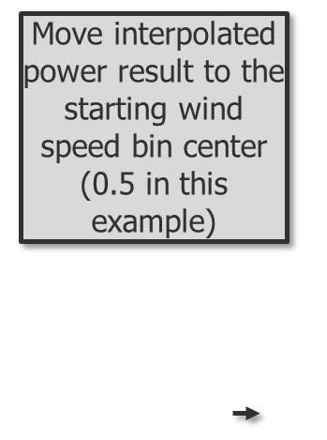
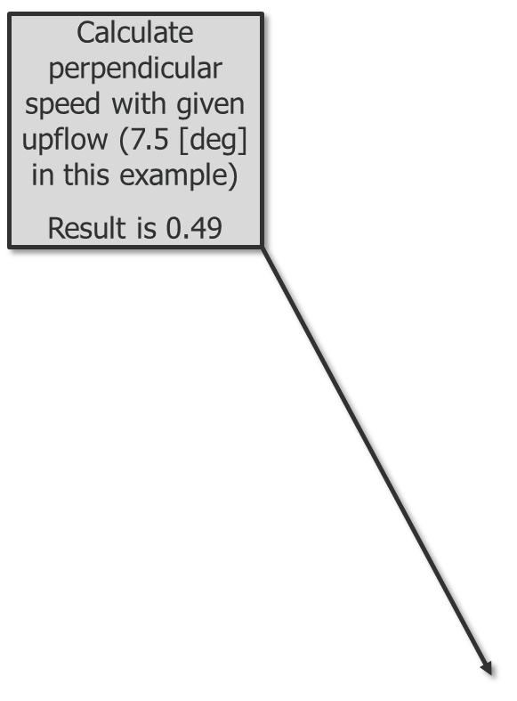
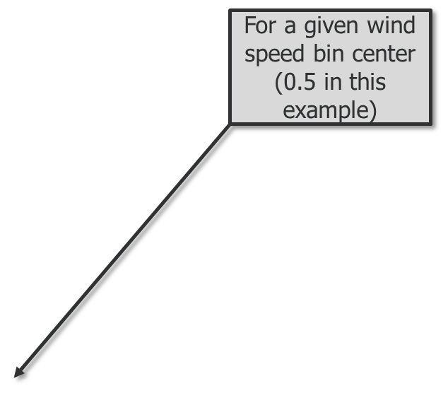
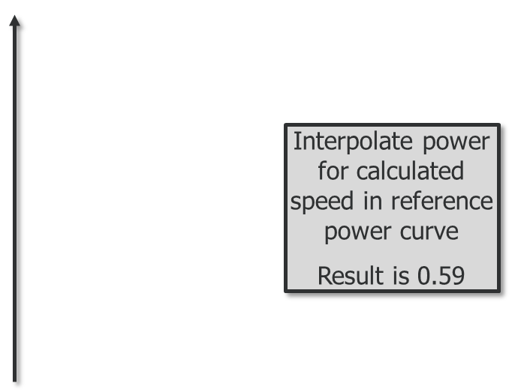
Upflow correction method
Site resources assessment
Presentation Gamesa 2014

Slide 14
Upflow correction method
Conclusions
Upflow angle is a key driver in power performance for complex and very complex terrain
In flat terrain, wind shear and veer are more important than upflow angle for the machine’s performance
The geometric upflow correction seems to work to predict power performance
Results of BEM simulations
Little empirical evidence
Presentation Gamesa 2014

Slide 15

Thank you
Presentation Gamesa 2014

Slide 16
Q & A
Presentation Gamesa 2014

